Slide 1

PROJECT WORK
ON
GYM SUBSCRIPTION MANAGEMENT SYSTEM
PRESENTED BY:​
Sharmila Pyatha (62920272020)​ Suman Mushyakhwo(62920322020)

Slide 2
Presentation
Introduction
Problem Statement
Objective
Development methodology
Requirement Analysis
Data Modeling
Process Modeling
Implementation Tools
Conclusion

Slide 3

INTRODUCTION
Using a web based Gym Subscription Management System provides users with access to fitness related activities, services, and information.​
Through their web browser, members can access a variety of fitness services, such as and workout routine plans, and track membership expiry through a web based fitness subscription system.​
Users can choose a Gym routine and subscription package based on their interests. ​

Slide 4
OBJECTIVES
To track the membership expiry date.​
To provide a proper exercise routine according to their body structure.
To make easier to keep record of members. ​

Slide 5

PROBLEM STATEMENT
The lack of effective and contemporary systems for managing fitness subscriptions in Nepal is the stated issue, which causes a number of problems including ineffective member data management, difficulty tracking subscriptions, and others.​
To member information, the majority of fitness centers in Nepal use mannual system.
The conventional paper based approach takes a lot of time, is prone to mistakes, and lacks the flexibility and convenience that today's members want.​
Furthermore, customizing formulas in Excel to meet their needs is exceedingly challenging.​
In order to successfully manage their memberships, fitness facilities and gyms need a digital solution.​

Slide 6
DEVELOPMENT METHOLOGY​
Spiral Model
Combines waterfall modeling with prototyping.
Facilitates adaptation and incorporation of changes to requirements during development.
Incorporates risk analysis and management at every stage.
Enhances security by addressing potential risks.
Increases the likelihood of preventing assaults and security breaches.
Chosen for system development due to its ability to satisfy all requirements.

Slide 7
Requirement Analysis​
Functional Requirements​
A member is be able to choose categories.​
A member is be able to request routine from the admin.​
An admin is be able to manage categories, routine and member database.​
A member is be able to see payment records from the beginning of his own.​
An admin is be able to retrieve payment records of all members.
A member is be able to view their subscription expiry date.​
An admin is be able to update members subscription date.​
An admin and members is be able to update their profile info.​

Slide 8
Non - Functional Requirements​
This system is very easy to use as it is written using basic html and PHP so that the user can interact with the system easily to do the needed work. ​
The system shall require a localhost server, database server, and a web browser to run successfully. ​
The system is compatible across all platforms under the required environment. ​
Every user shall have a unique Session while logging into the system. ​
The user password is in encrypted format in the database ​

Slide 9
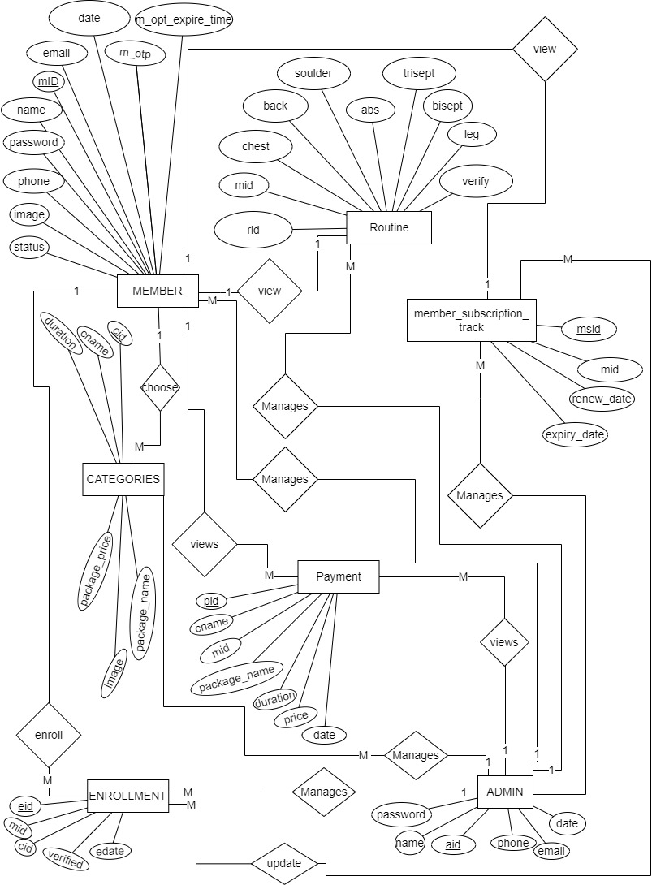
Data Modeling (ERD)​

Slide 10
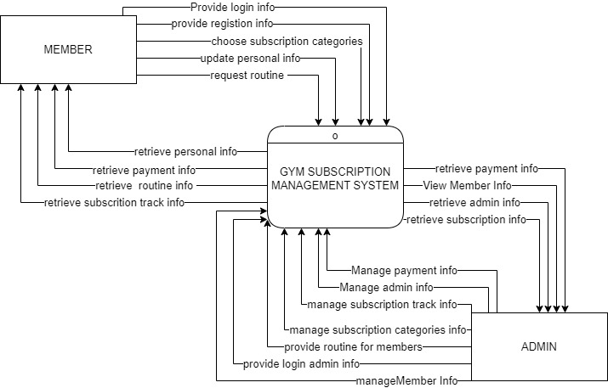
Process Modeling​
Context Diagram​

Slide 11
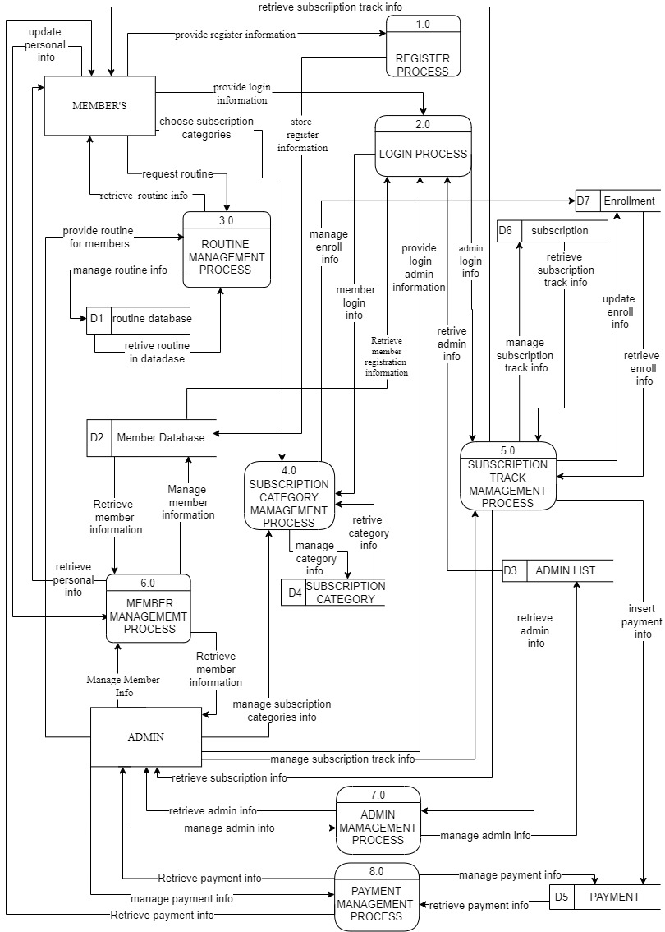
Level 1 DFD​

Slide 12
SYSTEM IMPLEMENTATION TOOLS
IDE : VS CODE​
DATABASE MANAGEMENT SYSTEM : MYSQL​
SERVER : APACHE​
DIAGRAMMING TOOL : DRAW.IO​
FRONTEND : HTML,CSS, JAVASCRIPT​
BACKEND : PHP​

Slide 13
CONCLUSION
The Gym Subscription Management System is a very important tool for gym managers and members alike. It makes the gym better for members and helps things run smoothly. This technology helps gym operators to track memberships and communicate with them more efficiently. It aids in resource allocation, employee management, and revenue growth. It also provides useful insights about member behavior and preferences, allowing for data driven decision making. The Gym Subscription Management System provides members with simplicity and transparency. They can simply join up for memberships, make payments, and check their account information via online. This improves their overall experience and fosters long term gym engagement.​
​ ​

Slide 14
REFERENCES​
[1] | GAMAGE, "Web based Gym Management System," [Online]. Available: https://dl.ucsc.cmb.ac.lk/jspui/handle/123456789/3899. [Accessed 2023].
[2] | A. KUMAR, "php gurukul," [Online]. Available: https://phpgurukul.com/gymmanagement-system-using-php-and-mysql/. [Accessed 10 9 2023].
[3] | N. Bajracharya, "Gym Management System in PHP MySQL," [Online]. Available: https://codeastro.com/gym-management-system-in-php-mysql-with-source-code/. [Accessed 20 May 2023].
[4] | A. KUMAR, "php gurukul," [Online]. Available: https://phpgurukul.com/how-tocompare-two-dates-in-php/.
[5] | R. S. Saud and M. Giri, Software Engineering, KEC, 2077.
[6] | S. B. Saud and I. Chaudhary, DataBase Management System, KEC, 2023.
[7] | draw.io, "Flowchart Maker & Online Diagram Software," app.diagrams.net, [Online]. Available: https://app.diagrams.net/

